Slide 1

PERCEPTIONS OF POVERTY
Rishi Dey Chowdhury, Anushka De, Shibendra Kumar Singh, etc.
*Free use for Educational Purpose only. Please cite if you use this work.

Slide 2
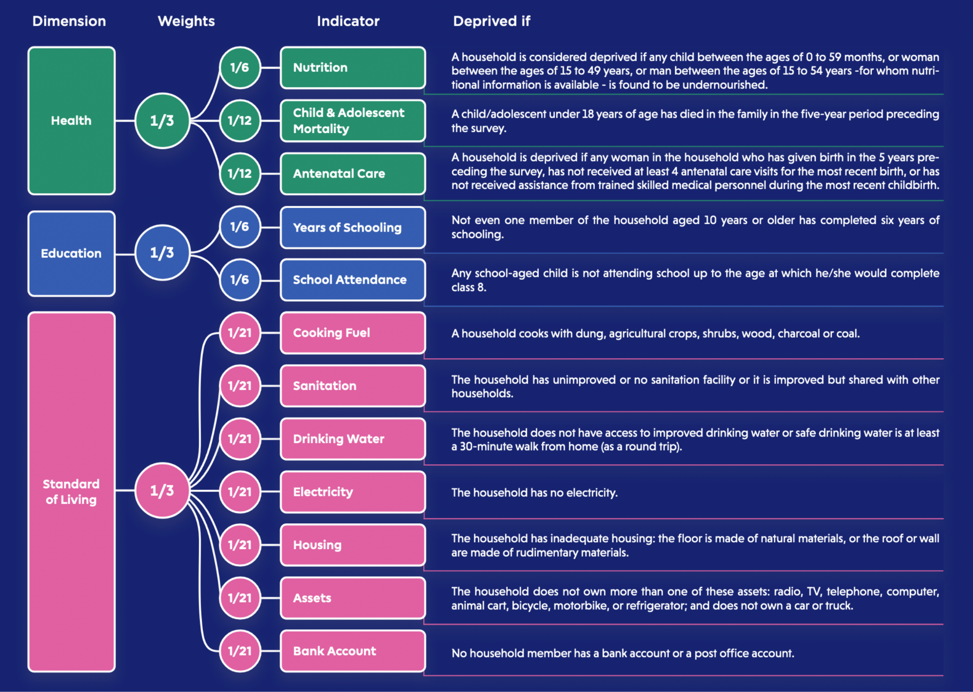
Multi-Dimensional Poverty Index
An weighted sum score calculated based on this chart is the Deprivation Score (DS) which translates to Poverty level of a person.
Here, we do not question the validity of MPI. But we want to improve on it to be apt for all class of people and across all regions across India.

Slide 3
The Problem
Regional Problems
Indian Context
Problem statement
Many of the indicators does not portray the true picture of poverty or deprivations faced by people living in a region.
Current weighting scheme doesn’t take into account this factor.
The MPI Indicators are taken directly from global MPI model. This makes it less accurate in Indian context.
Need to revisit the indicators and improve their quality.
Design a weighting scheme which is more robust and flexible: - Adaptable Weights - Weights ∝ Deprivation - The Indicators truly capture what is intended

Slide 4
Challenges deep-dive
Challenge 1
Challenge 2
Challenge 3
Design Questionnaire
The questionnaire should ideally touch upon all the important aspects required to validate the weights and make them adjustable. Also the validity of the indicators.
Collect Data
We can help ease out this step of survey by following the sampling scheme of NSSO. We must collect as much bg info about a place in advance as possible and frame the qsns accord.
Inference and Benchmark
We will have to infer from whatever response we get from the survey. Translate it into meaningful decisions for policy makers and also validate our empirical results with past data.

Slide 5
CAP Framework
An effective framework which can be leveraged to design questionnaire and estimate weights for MPI
Contrastive Allocative Perturbative (CAP) Methodology

Slide 6
Design

Slide 7
The Questionnaire Structure
Emphasis should be put on the fact that the respondents should be encouraged to answer this question keeping in mind their locality and not the entirety of the city or India
Collect as much background information about the place from secondary data, if possible, where survey will be conducted to calibrate the two extremes of the poverty scale and available facilities to frame targeted questions and reduce redundancy.
To identify the relative importance between two or more indicators, we design situations where the respondent have to decide who can be deemed poorer than the other
Contrast
Questionnaire
Allocation
To identify the poor indicators, we design situations where the respondent have to decide the indicator status for an average man of that region/community
Collect information regarding socio-economic background of the respondent.
Perturb
Past MPI Data collected can give us prior idea in selecting which questions to ask.
To identify the optimum threshold of one indicator by finding the bare minimum requirement of this indicator such that a person is not deemed poor, we design such situations with different levels of this indicator

Slide 8
Sample Questions

Slide 9




Contrastive Comparison
Rank the following according to their level of poorness. The other indicators not mentioned remain the same across each person.
A
B
C
✅
✅
❌
❌
✅
✅
✅
❌
✅

Slide 10
Framing the Comparisons
I: We should keep the number of ❌ same in each person, o.w. one with more ❌ will be selected as more poor.
I: To reduce the no. of questions we can compare good indicators among themselves and same for bad ones.
I: If some region is not having good medical facilities then at least one of our ranking question must have one ✅ and one ❌ for one of the medical indicators.
Why? To understand if they really feel deprived of that
What is good? The indicators which received higher score
Past MPI data can come into play. More on it Later
What is bad? The indicators which received lower score

Slide 11
Between the Broad indicators
Q: ✅ Schooling, ✅ Nutritious Daily Meal, ❌ Electricity
Q: ✅ Water, ❌ Children Care, ✅ Education
Q: ❌ Bank Account, ❌ Antenatal Care, ✅ Education

Slide 12


















Allocation Analysis
In your opinion what should be the allocation of indicators for an average man in this region?
Health
Education
Standard of Living
We may provide the background of the average man depending on the average income, family size and education level of that region.

Slide 13
Between the Broad indicators
Q: Would you choose paying medical bills over your child’s school fees?
Q: If you have money so that you can either spend over your child’s school fees or eating a month’s two times a day nutritious meal , what would you choose?
Q: Would you consider expenditure for antenatal care more important than paying for electricity?
Q: Which is more important for you: use of cooking fuel or payment of your child’s school fees?

Slide 14
Within the Indicators
Q: What would you prioritize: payment for electricity or payment for clean drinking water?
Q: Is living in a pucca house more important for you or having access to electricity?
Q: Which is more important for you:living in a pucca house or having a bank account?
Q: Which is more important for you: owing a T.V. or having a bank account?

Slide 15


Perturbation Performance
Whom out of the following will you consider to be NOT poor? More than one person can be chosen.
A
B
C
D
Attended School Upto Class 8
Attended School Upto Class 10
Attended School Upto Class 12
Graduated

Slide 16
Benefits of CAP Framework
Better, Flexible and Accurate Methodology

Slide 17



How CAP Framework Outstands?
Mitigate Bias
Measures Deprivation
Capture Regional View
- We never ask the respondent about his situation. - We always present the respondent with schematics of a person which helps reduce false response or bias.
- Help Figure out the threshold of deprivation for many indicators. - People have to prioritize between the indicators which help identify the levels of deprivation.
- Helps bring out the implicit and explicit views on various indicators in that region. - Allows us to inculcate regional aspects and poverty extremes in our questionnaire to make them more relatable

Slide 18
Past MPI Data
Adding Insights for framing regional questions

Slide 19
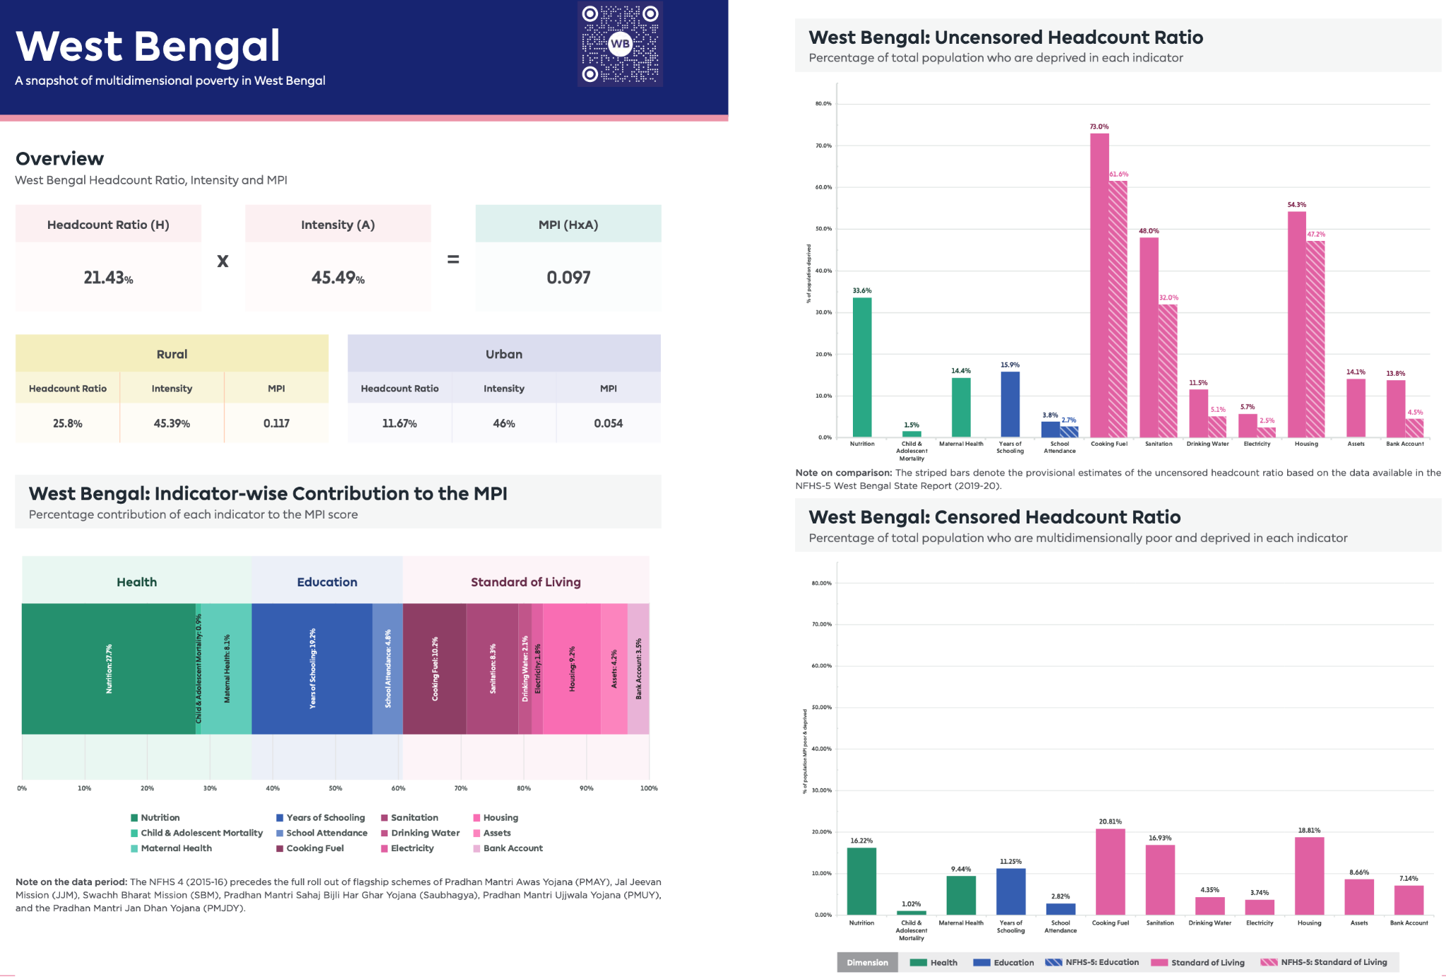

Slide 20
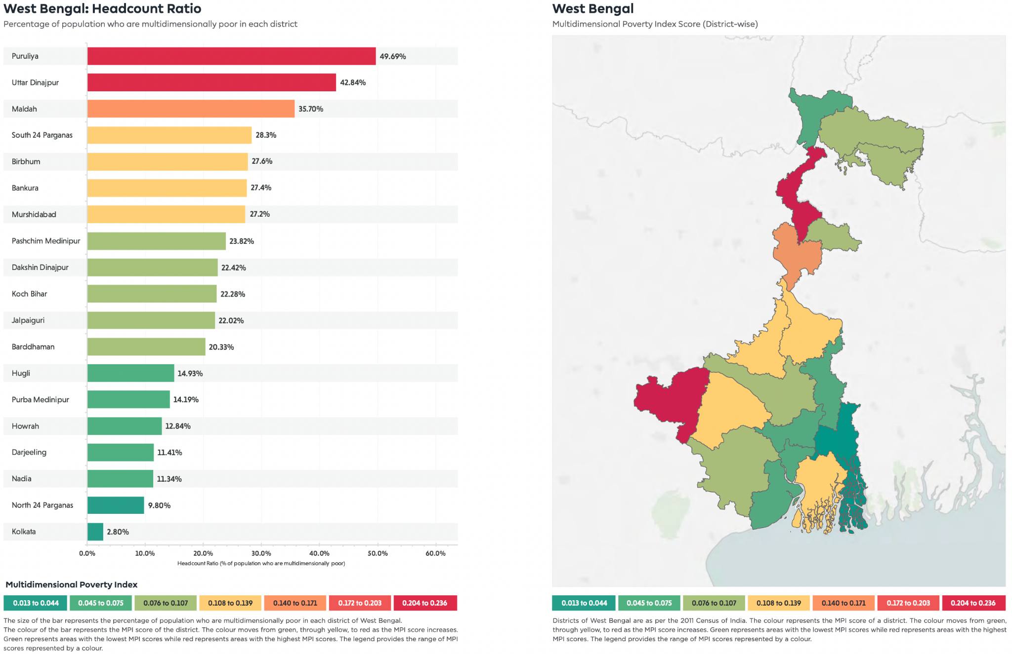
✔️
Based on the Multidimensionally Poor Headcount Ratio, we decide to do our study in these two districts
✔️

Slide 21
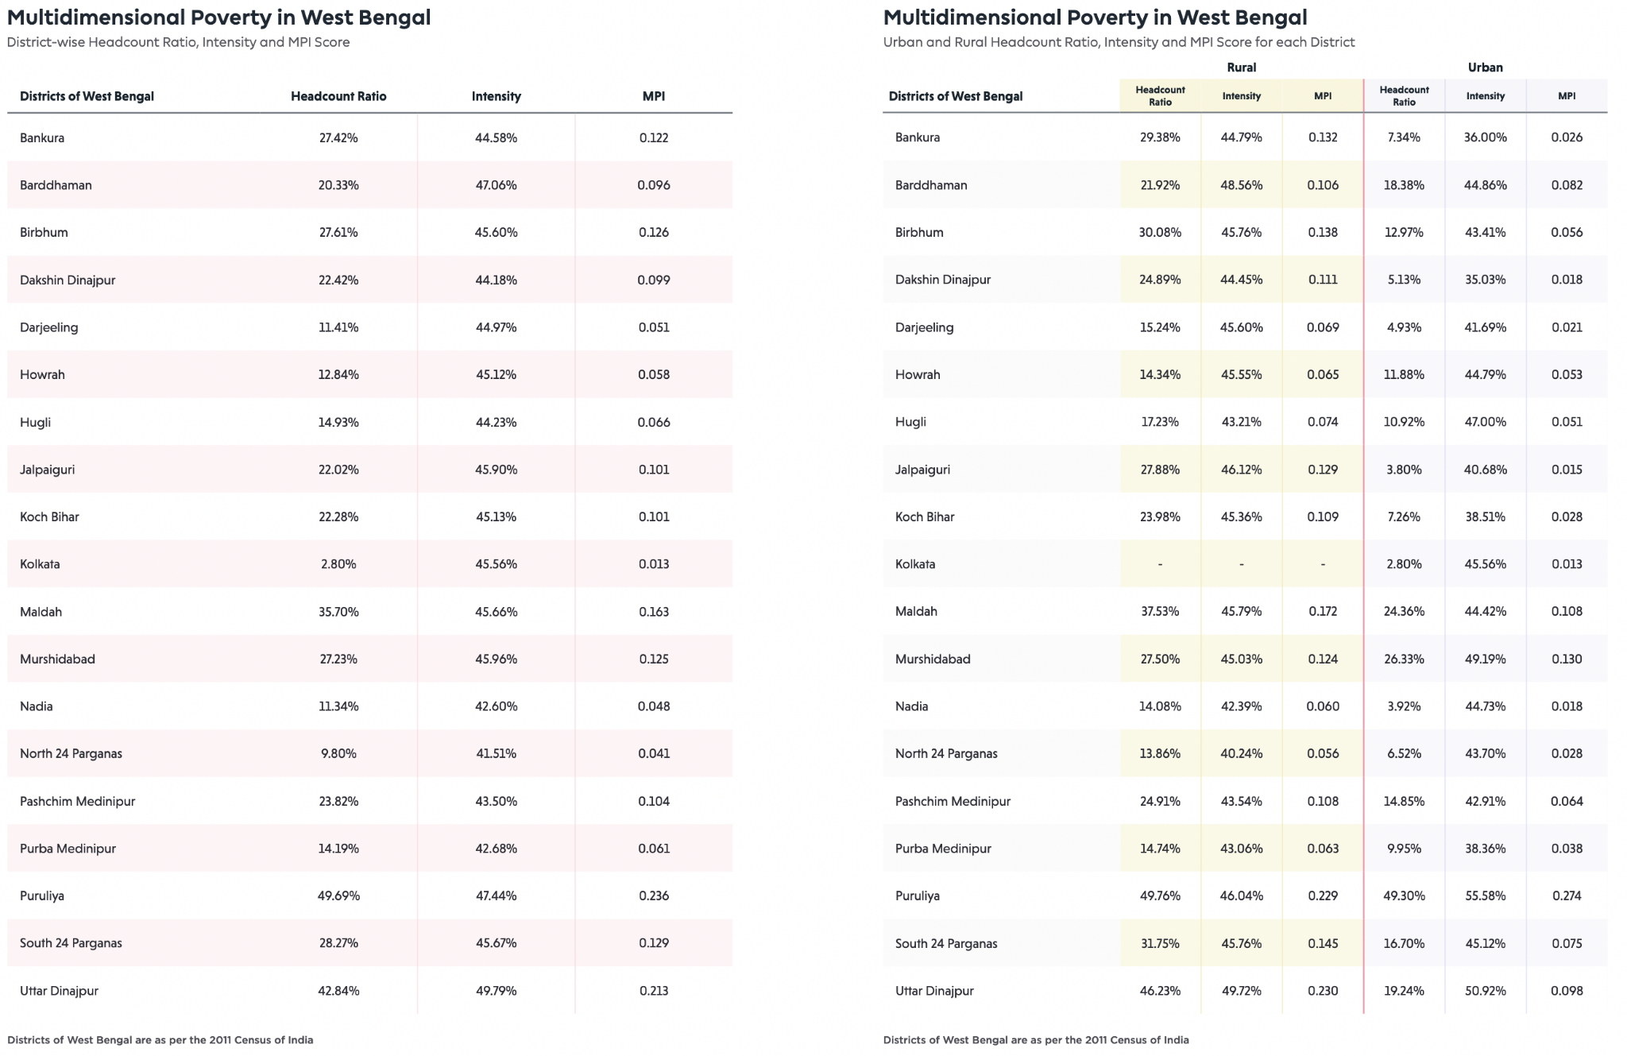

Slide 22
Questionnaire

Slide 23
Questionnaire
Designing the Survey Questions

Slide 24
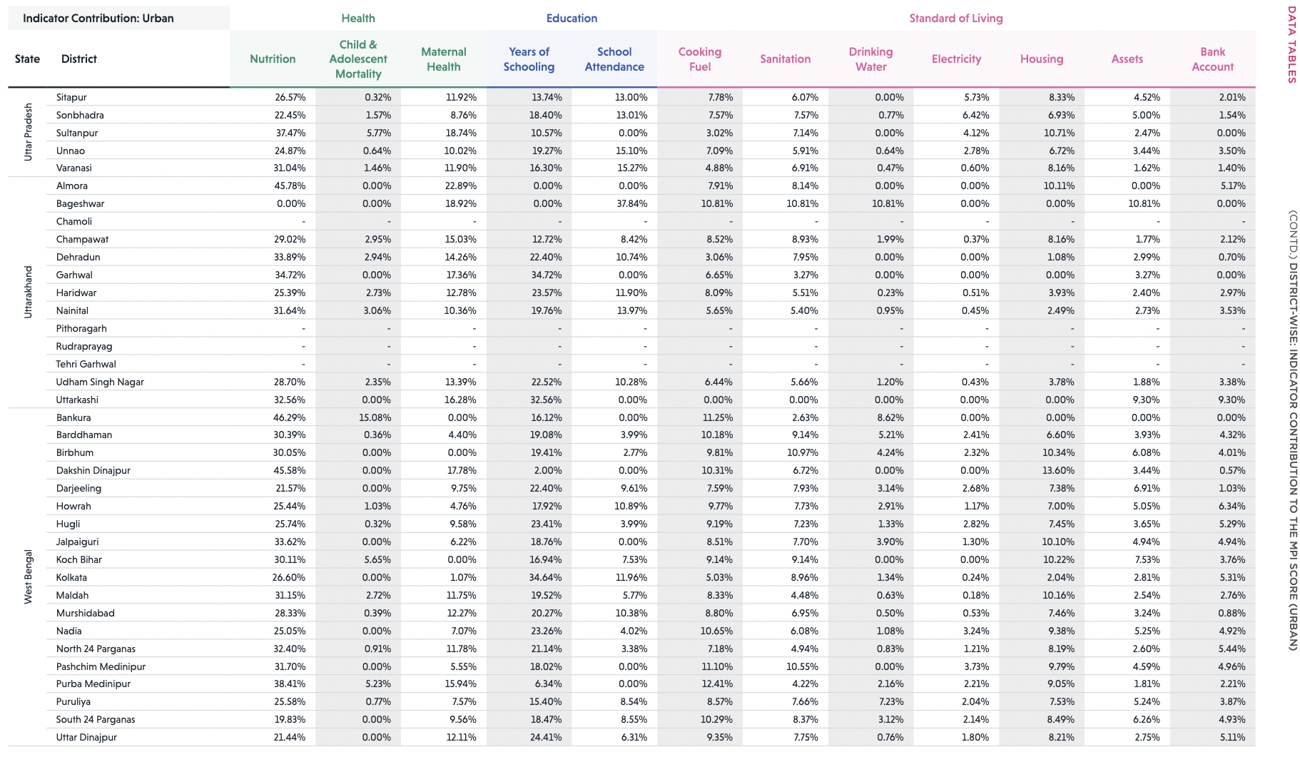
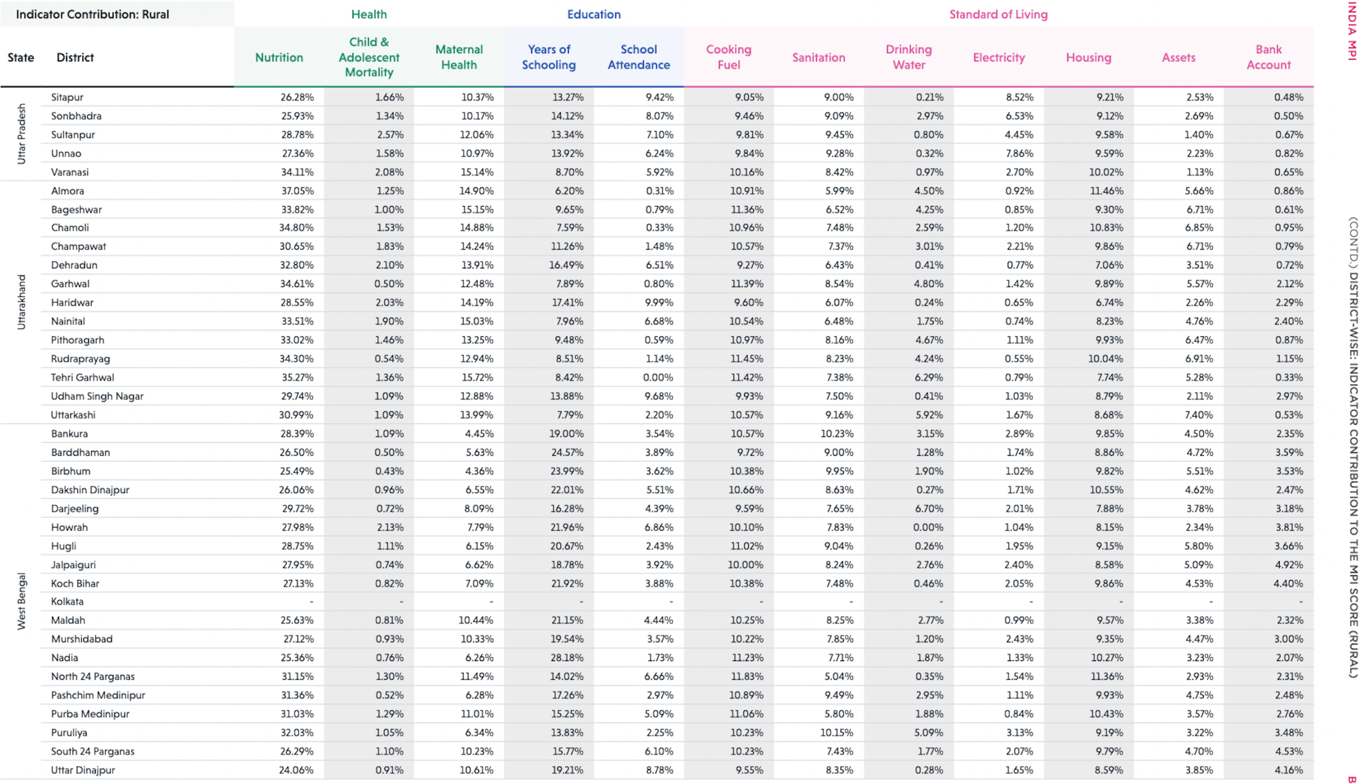

Figuring Out Good and Bad Indicators
What is good? The indicators which have higher contrib.
As discussed earlier, We need the good and bad indicators to consider only important comparisons
Circled ones have higher contribution ( >7% )
What is bad? The indicators which have lower contrib.
The contribution of an indicator provides an insight into the relative deprivation in a particular indicator based on the weight attached to that indicator — NITI AAYOG Report - Based on NHFS 2015-2016
Indicator Contribution
Urban
Rural

Slide 25
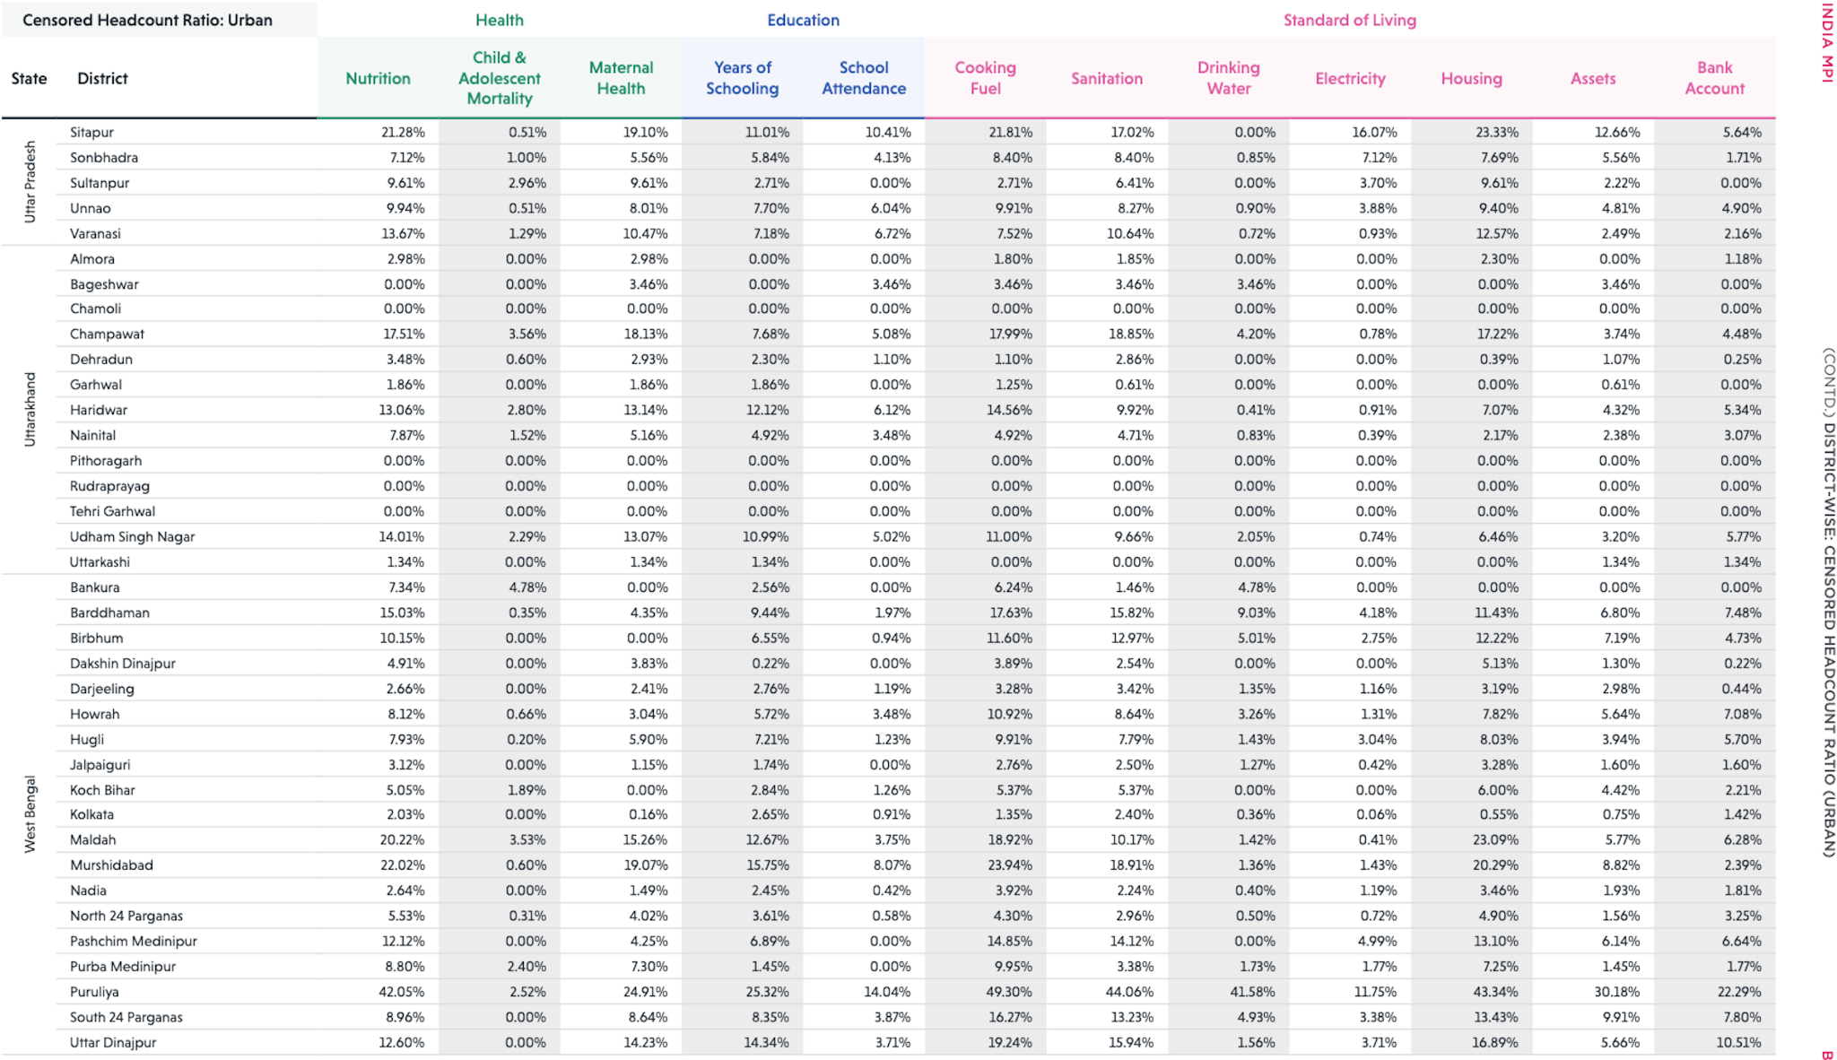
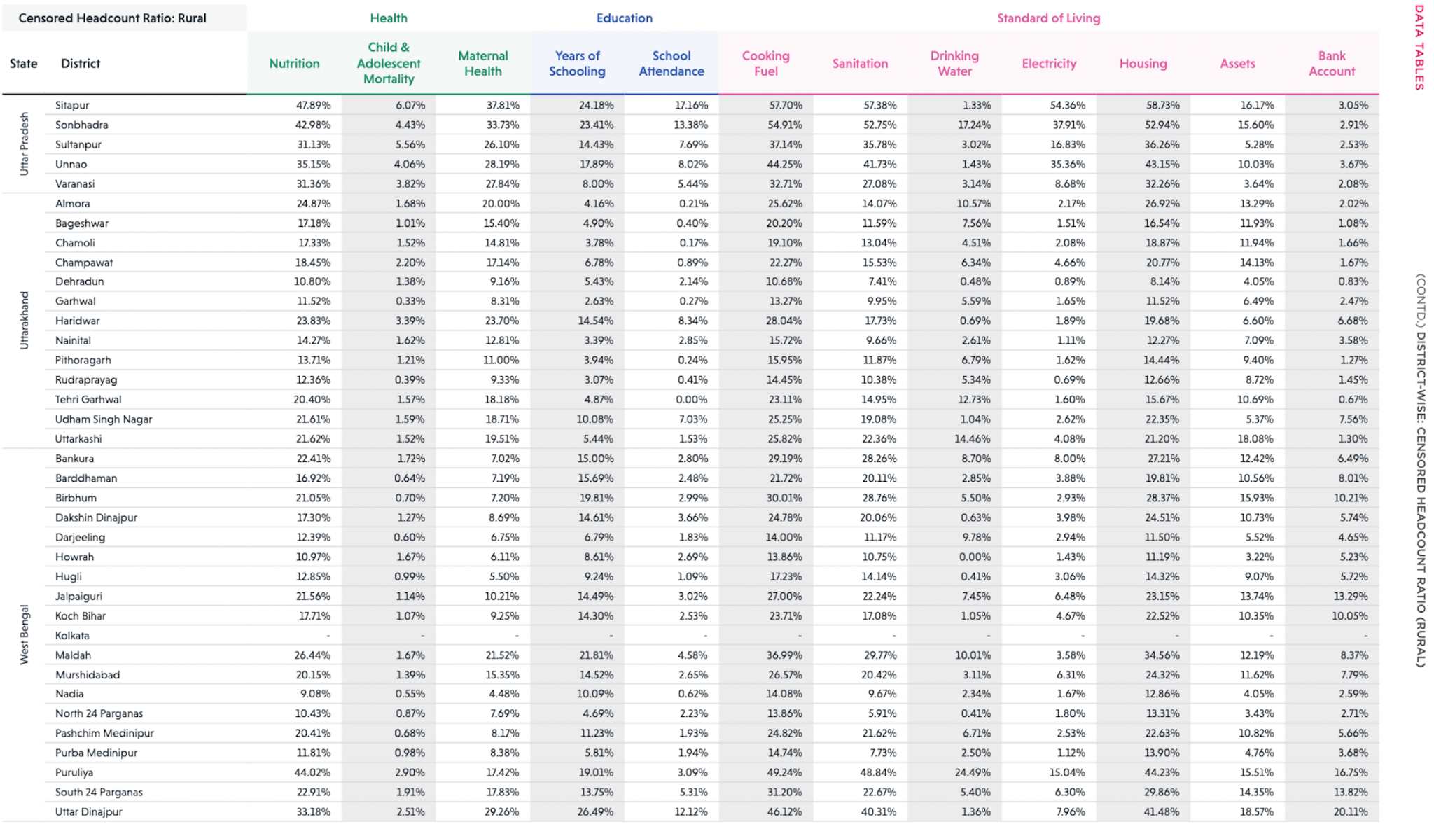
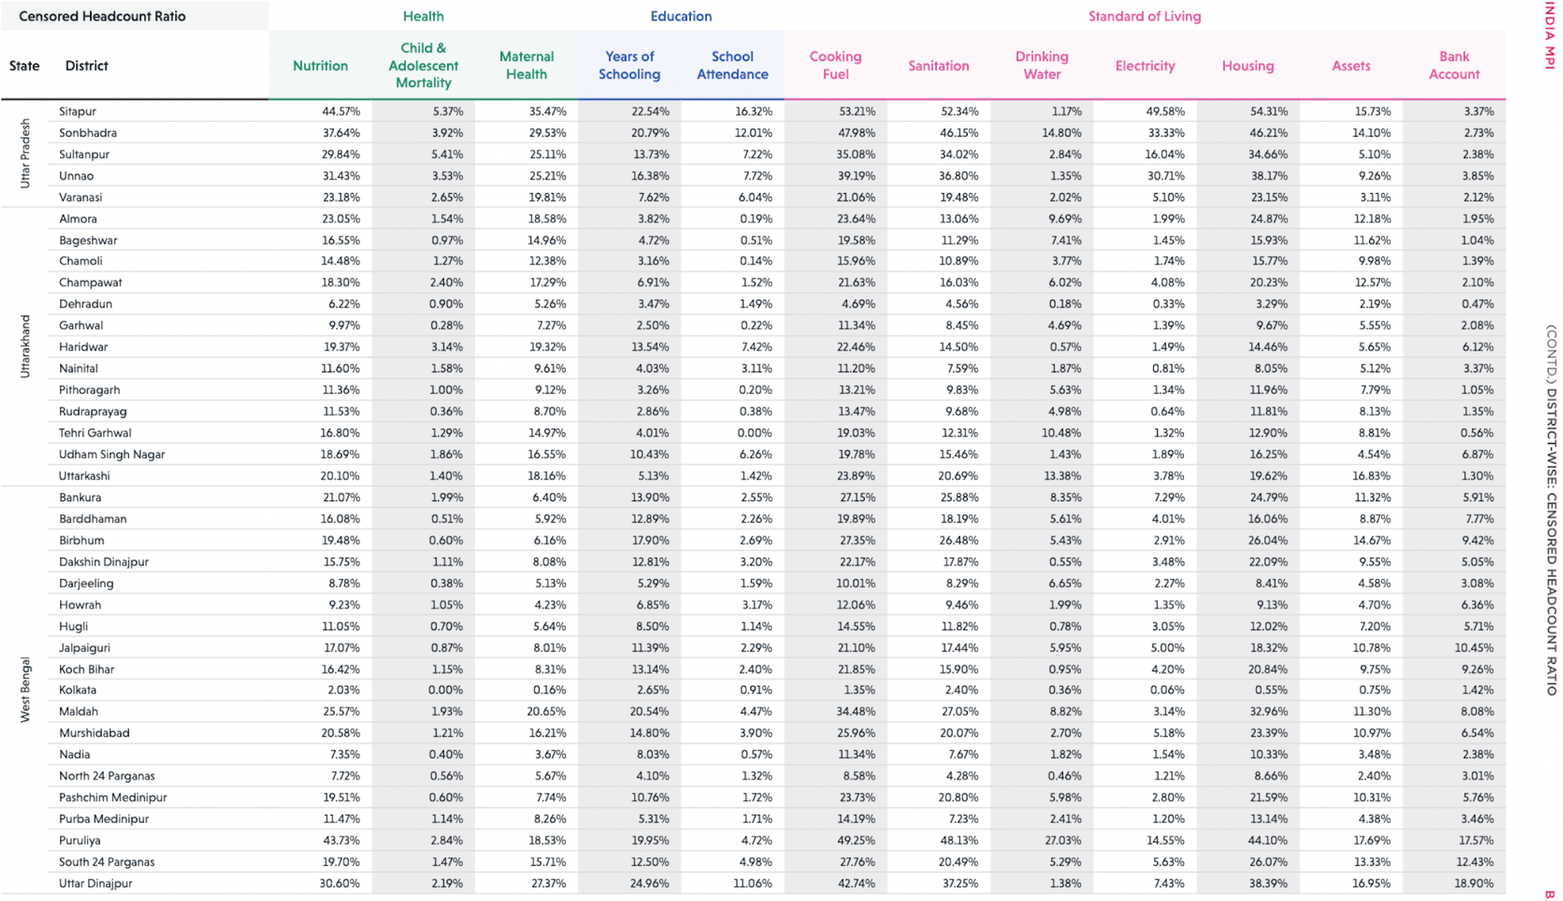
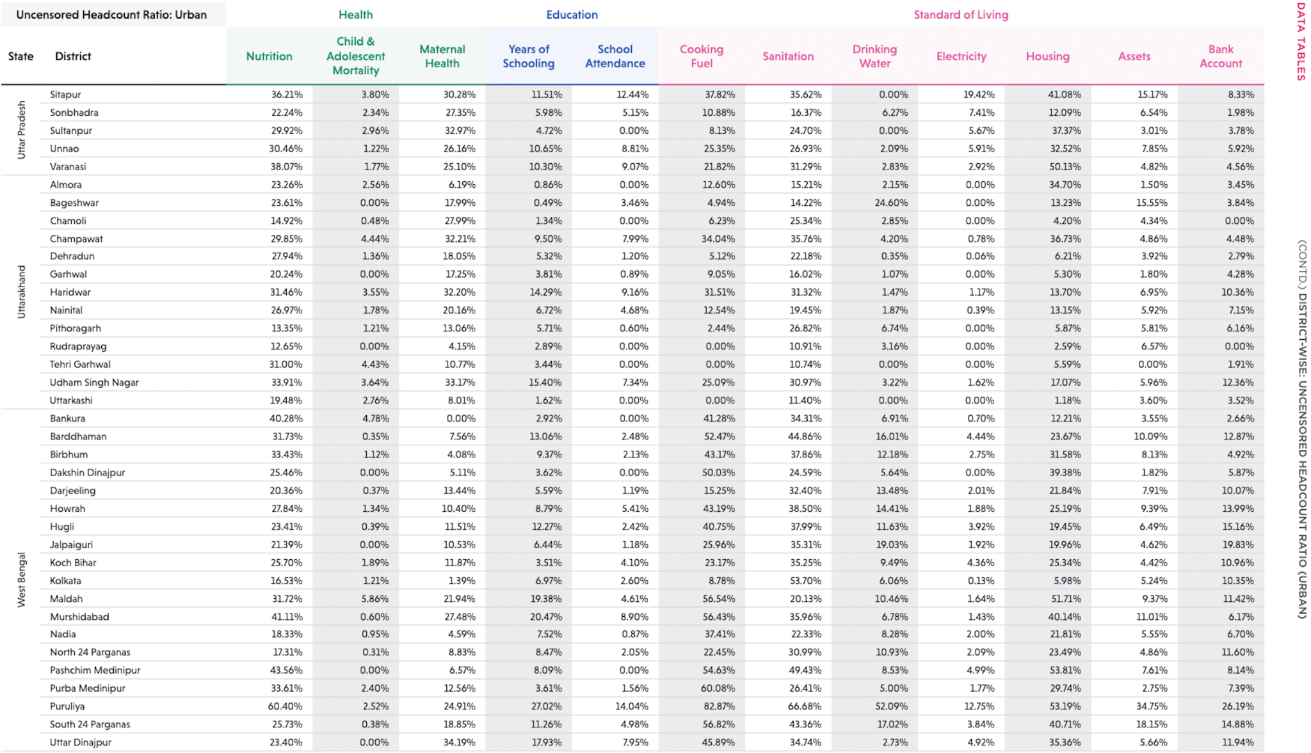
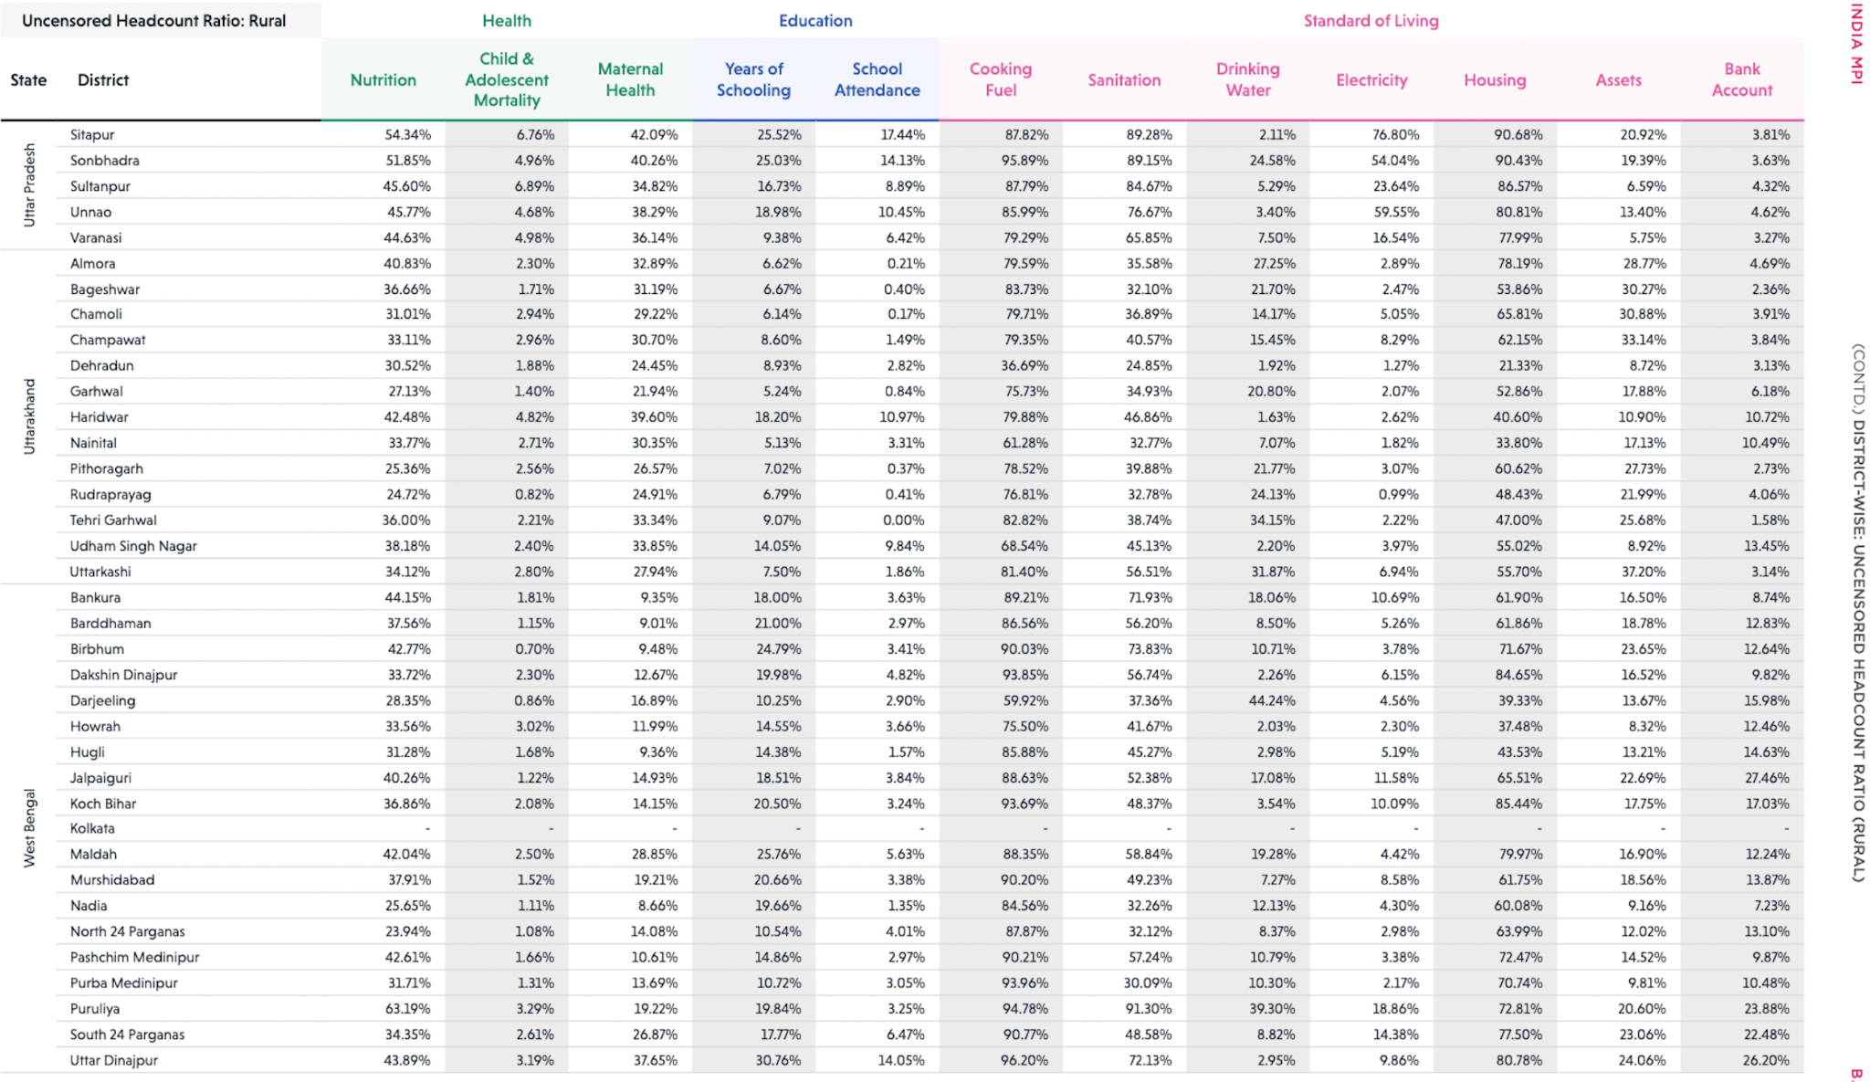
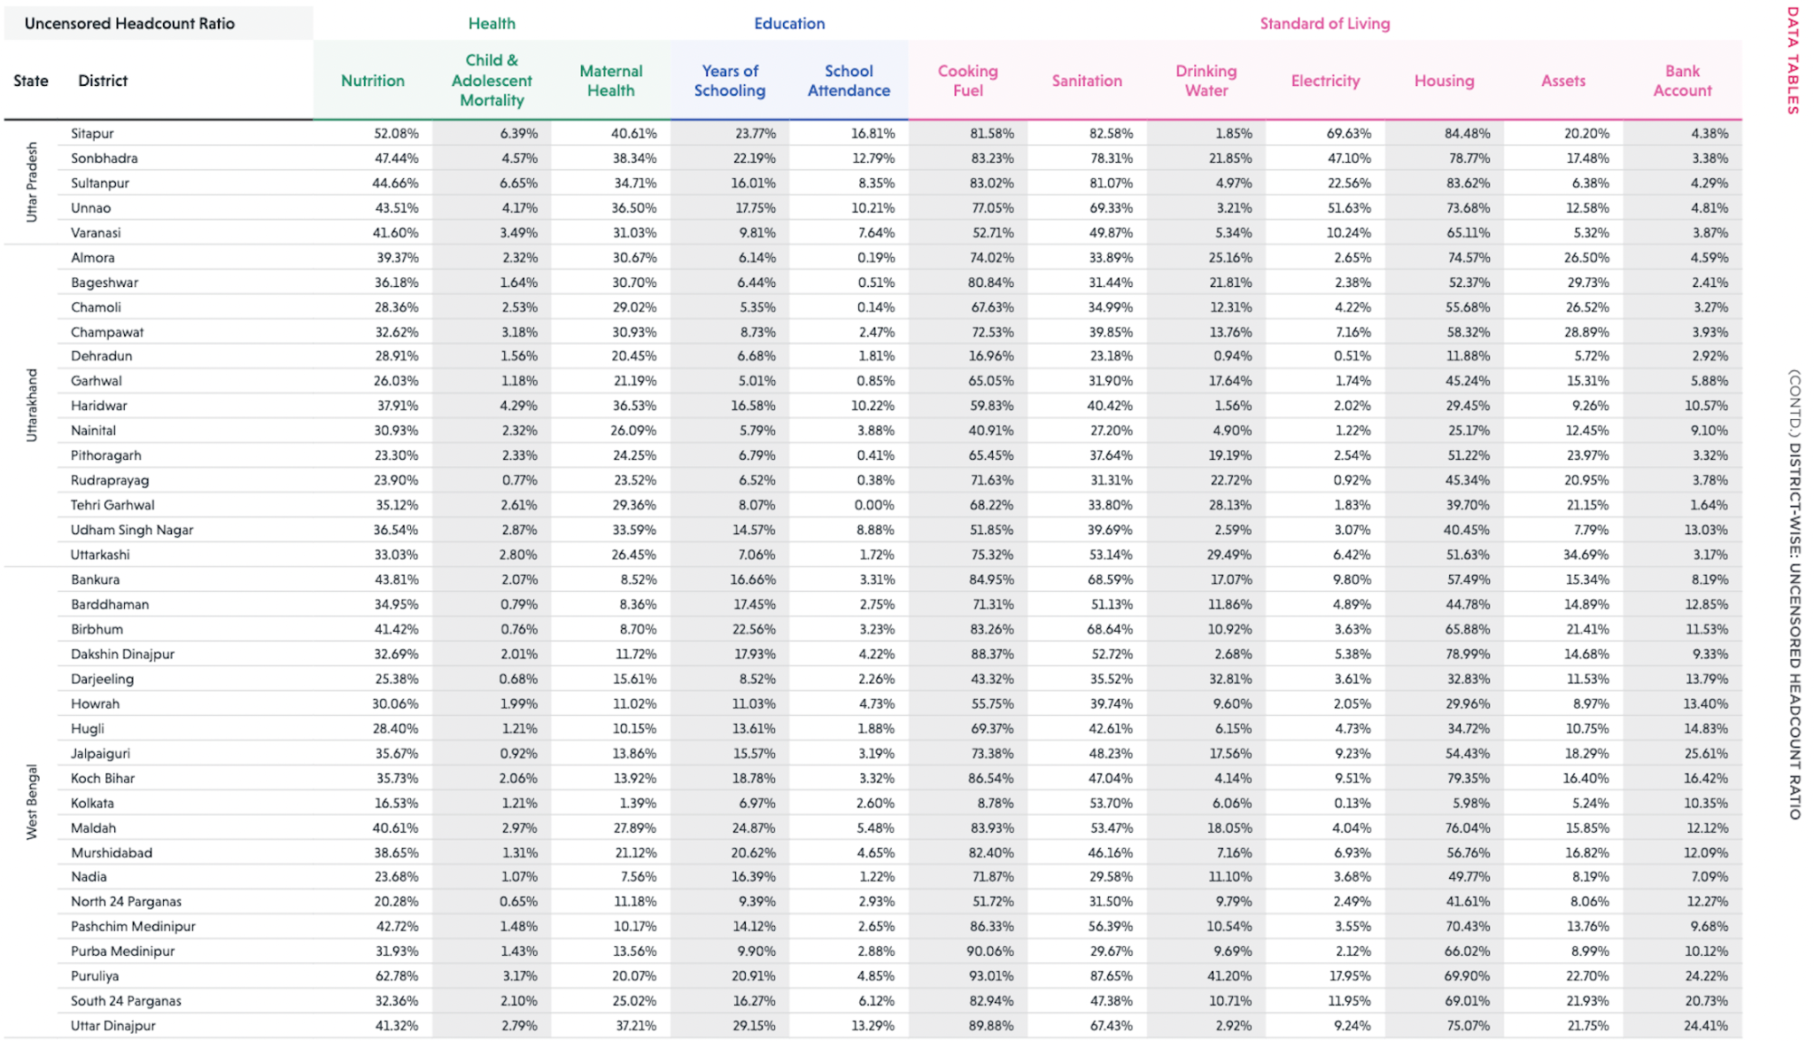
Censored
Urban
Rural
Overall
Uncensored
NITI AAYOG Report - Based on NHFS 2015-2016

Slide 26
Buckets for Contrastive Comparison
Higher contribution to MPI or Poverty
Nutrition
Years of Schooling
Good Indicators
Cooking Fuel
Good Indicators
Sanitation
Housing
Only for Urban
Paschim Medinipur
Urban/Rural
Maternal Health
South 24 Parganas
Urban/Rural
Child and Adolescent Mortality
School Attendance
Bad Indicators
Drinking Water
Bad Indicators
Electricity
Assets
Lower contribution to MPI or Poverty
Bank Account
We will focus on comparison between each bucket
Takes into account regional information
Support of prior data helps cut redundant comparisons

Slide 27
Contrastive Comparison
Q: ✅ Having an Educated Family Member, ✅ Nutritious Daily Meal, ❌ Cooking Fuel Q: ✅ Cooking Fuel, ✅ Proper Sanitation, ❌ Proper Housing
Q: ✅ Electricity, ✅ Assets, ❌ Bank Account Q: ✅ Maternal Health, ✅ Drinking Water, ❌ School Attendance
Q: ✅ Child & Adolescent Mortality, ✅ Drinking Water, ❌ School Attendance
Q: ✅ Maternal Health, ✅ Assets, ❌ School Attendance Q: ✅ Electricity, ✅ Drinking Water, ❌ Bank Account
Q: ✅ Child & Adolescent Mortality, ✅ Electricity, ❌ Bank Account
Q: ✅ Having an Educated Family Member, ✅ Nutritious Daily Meal, ❌ Cooking Fuel Q: ✅ Maternal Health, ✅ School Attendance, ❌ Proper Housing
Q: ✅ Cooking Fuel, ✅ Proper Sanitation, ❌ Proper Housing
Q: ✅ Having an Educated Family Member, ✅ Nutritious Daily Meal, ❌ Cooking Fuel Q: ✅ Maternal Health, ✅ Proper Sanitation, ❌ Proper Housing
Q: ✅ Assets, ✅ Bank Account, ❌ Drinking Water Q: ✅ Drinking Water, ✅ Electricity, ❌ Child & Adolescent Mortality
Q: ✅ School Attendance, ✅ Assets, ❌ Bank Account Q: ✅ Drinking Water, ✅ Electricity, ❌ Child & Adolescent Mortality
Good Indicators
Urban/Rural
Paschim Medinipur
Urban
Bad Indicators
Took into account the magnitude of indicator contribution also to frame better comparisons
Rural
Urban
Good Indicators
Rural
South 24 Parganas
Urban
Bad Indicators
Rural

Slide 28
Allocation Analysis
In your opinion what should be the allocation (0-1 status) of indicators for an average man in this region?
Health
We may provide the background of the average man depending on the average income, family size and education level of that region.
Education
Standard of Living

Slide 29

Perturbation Performance
Whom out of the following will you consider to be NOT poor? More than one person can be chosen.
Attended School Upto Class < 8
Has None of the Assets
Attended School Upto Class 8
Has 1 of the Assets
Attended School Upto Class 10
Has 2 of the Assets
Attended School Upto Class 12
Has 3 or more of the Assets

Slide 30
Data Collection

Slide 31




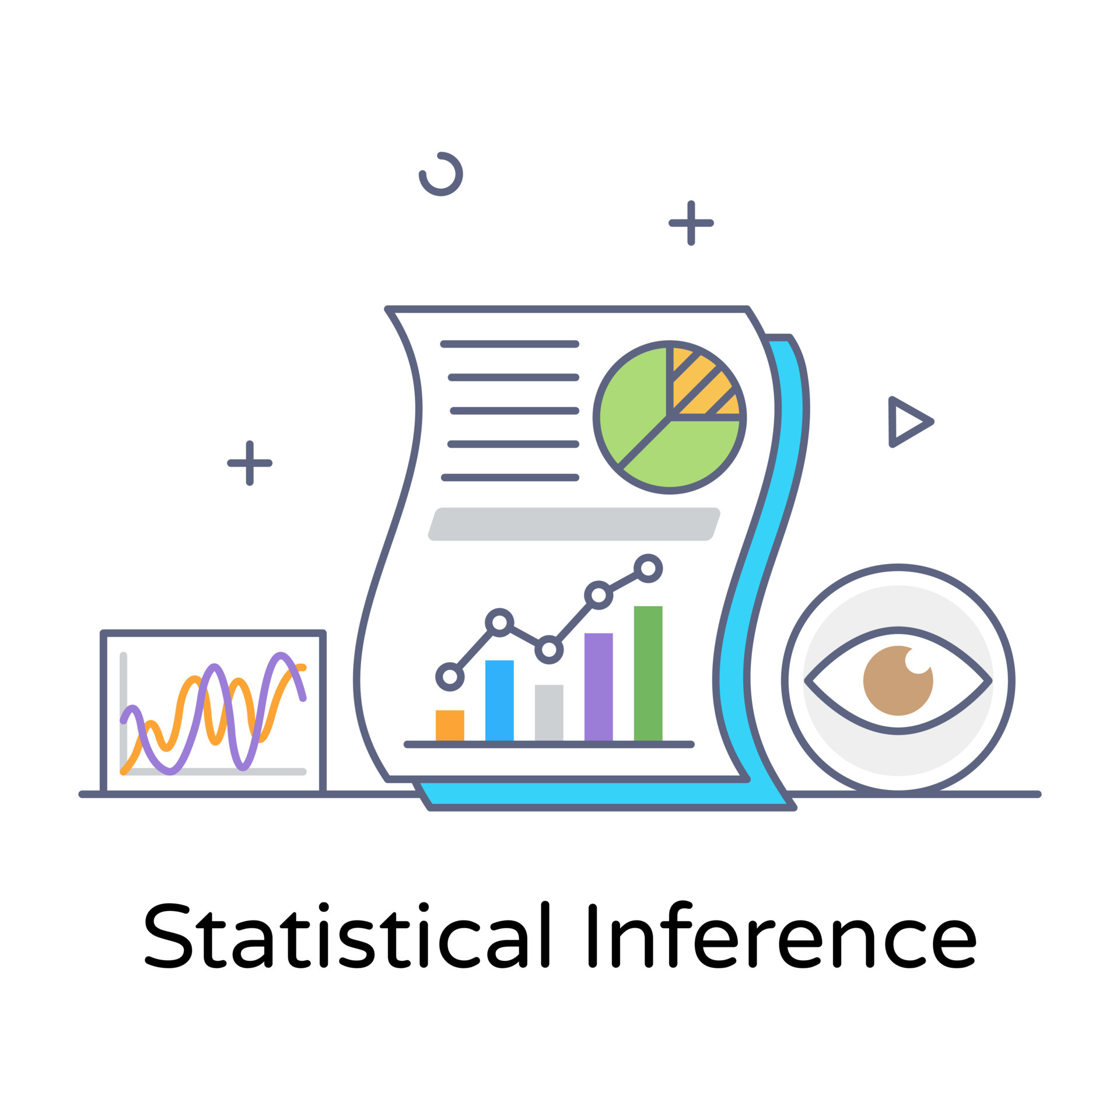

What to Collect?
Choose Households Based on help from Municipality or Panchayat
Establish Rapport
Ask About Socio-Economic Background
Observe Household Condition
Establish Rapport
Ask About Socio-Economic Background
Can we change the questions to be asked using some strategy? To probe more into the perspectives
Ask Questions
Carry out Inference
Each of the 3 people in the survey group should mark the household poor/not poor

Slide 32
Inference
CAP Estimate
Estimation and Interpretation
of Weights

Slide 33
Aim of Our MPI Model
Motivation for the weight estimation scheme

Slide 34
What are we looking for in our MPI Model?
Design Better Indicators which capture deprivation better
The weights should be interpretable and convey the perception of poverty regarding various indicators
Interpretable
Weights
Indicator Weights ∝ Deprivation Level
(Separate Work)
If a person feels deprived of an indicator more than another shouldn’t it contribute more to the deprivation score?
MPI Model
Adjustable Weights
Weights must change from region to region for us to take into account the background of that place and incorporate that prior in our model as well as fit the needs of the people better
Poverty is never a global concept, it varies from place to place depending on what is available and what is the overall background of people in that region
Region-wise Different Indicator Weights

Slide 35

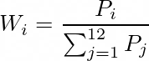
Weight Estimation
P1
What we need to estimate from our data is the proportion of people who feel deprived for each indicator.
P2
Use the Normalized Proportion of People who feel Deprived of an Indicator as the Weight Estimate for that Indicator in that Region.
P3
Health
P4
Education
P5
P6
P7
P8
Standard of Living
P12
Wi = Weight of Indicator
Pi = Proportion of People who feel Deprived
P9
P10
P11
Indicator Weights ∝ Deprivation Level

Slide 36


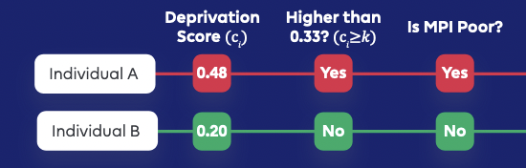


Why not go for Regression-Based Estimate?
Logistic Regression kind of setup requires us to label the respondents as poor/not poor
Brings in personal perception of poverty
Our/Policy Maker’s judgement should only creep in at the very last in deciding what should be the threshold above which an individual will be deemed Multidimensionally Poor
Model Estimated Weights are highly influenced by our perception
Better to let the people’s deprivation decide how much each indicator should contribute to their poverty

